Slide 1


Cryptocurrency Research And Analytical Tool
28/05/2022

Slide 2

BE Project: Presentation on,
Cryptocurrency Research And Analytical Tool
By,
Group No: 09
Vedant Mulherkar
Avinash Mankar
Ganesh Vispute
Guided By
Prof. Sandip Kahate
Dept. of Computer Engineering
MET’s Bhujbal Knowledge City, Institute of Engineering
28/05/2022

Slide 3
Index
Problem statement of the project
Terminologies about the concept of cryptocurrency
UML Diagrams
I. Data Processing diagrams
II. Data Flow Diagram.
III. Use Case Diagram.
IV. Sequence Diagram.
Concept of LSTM Algorithm/ Mathematical Model
Proposed System Model
Currency Comparison model
Currency value conversion model
Outcomes
Testing
Conclusion
References
28/05/2022

Slide 4
PROBLEM STATEMENT OF PROJECT
Creating software that contains the features of prediction, comparison, and conversion of cryptocurrencies with the help of their past data history.
28/05/2022

Slide 5

TERMINOLOGIES ABOUT CRYPTOCURRENCY
28/05/2022

Slide 6
Terminologies to cryptocurrency
What is cryptocurrency?
What is its history?
Why it is a current boom?
Importance of a Prediction model.
Advantages of LSTM algorithm in Prediction models.
Use of machine learning for the prediction model.
Need of Prediction model in the financial world.
28/05/2022

Slide 7
Flow of project
Getting cryptocurrency data.
Pre-processing of Data
Data Normalization
Prepare data for training and testing.
Predict the price of cryptocurrency using the LSTM algorithm.
Comparison model
Conversion model
28/05/2022

Slide 8
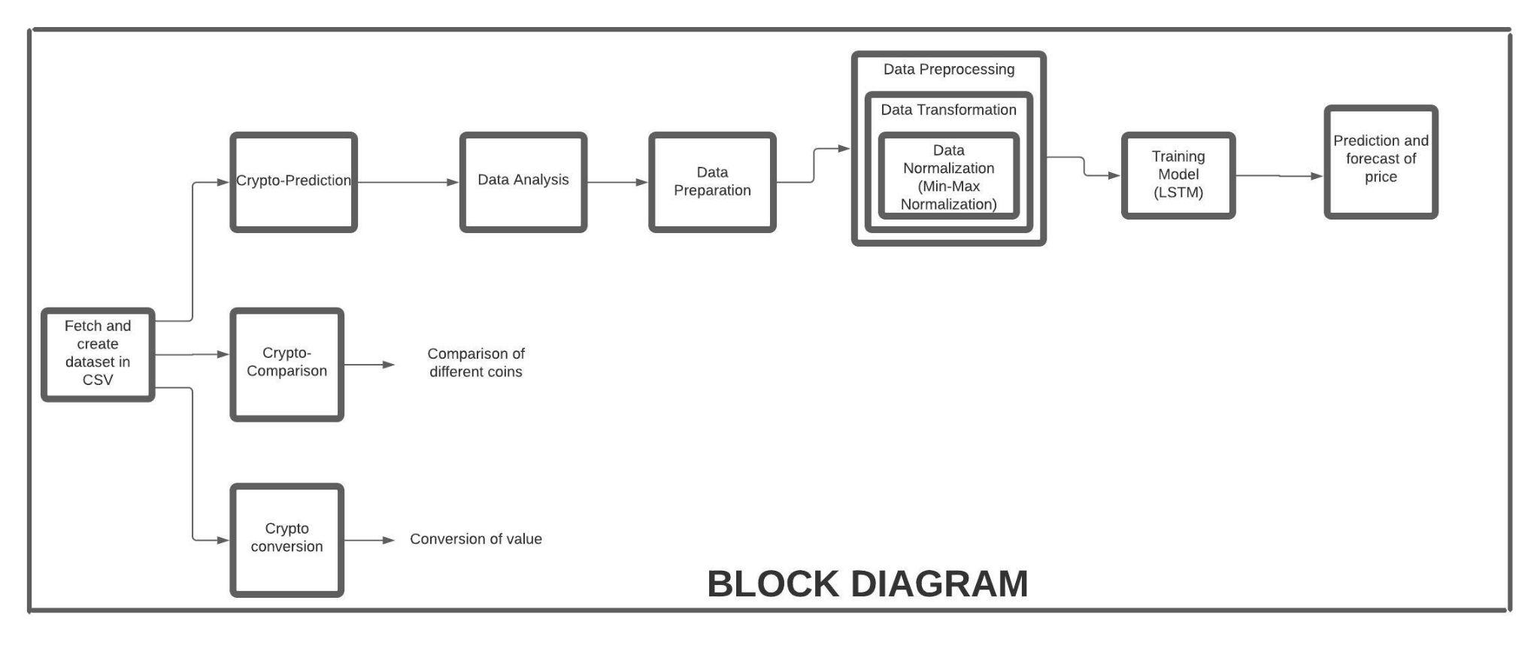
Block Diagram
28/05/2022

Slide 9
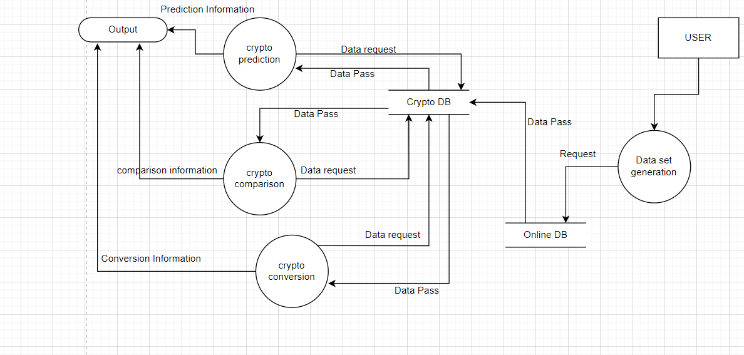
DATA FLOW DIAGRAM
28/05/2022

Slide 10
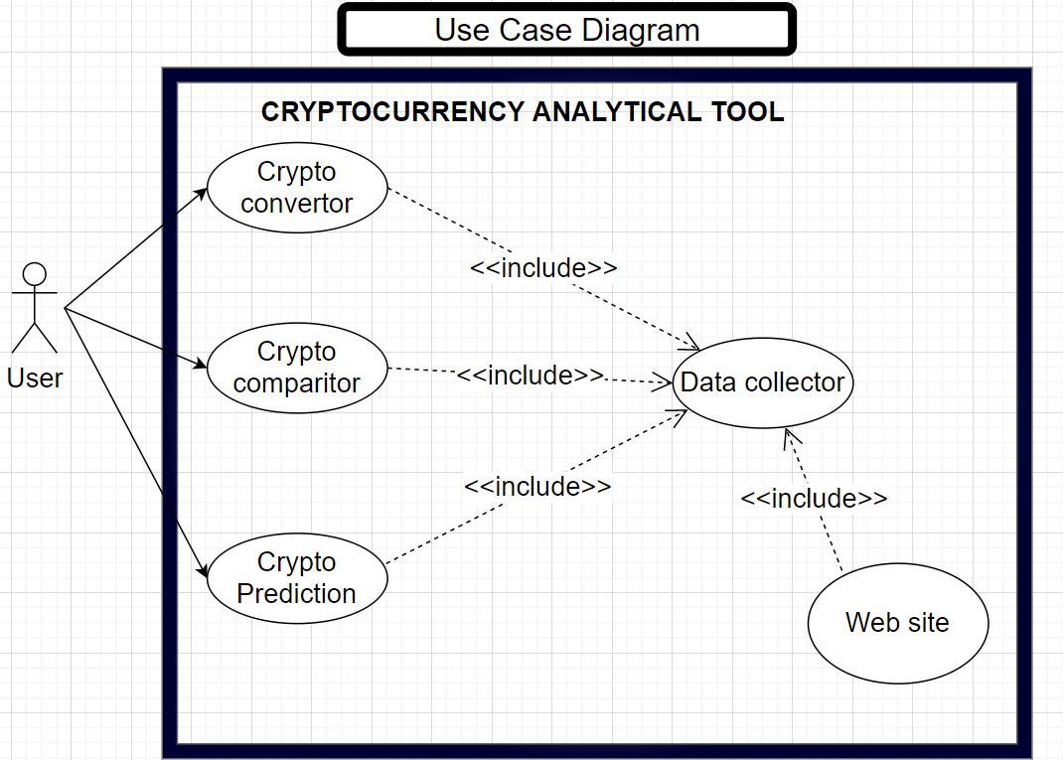
28/05/2022

Slide 11
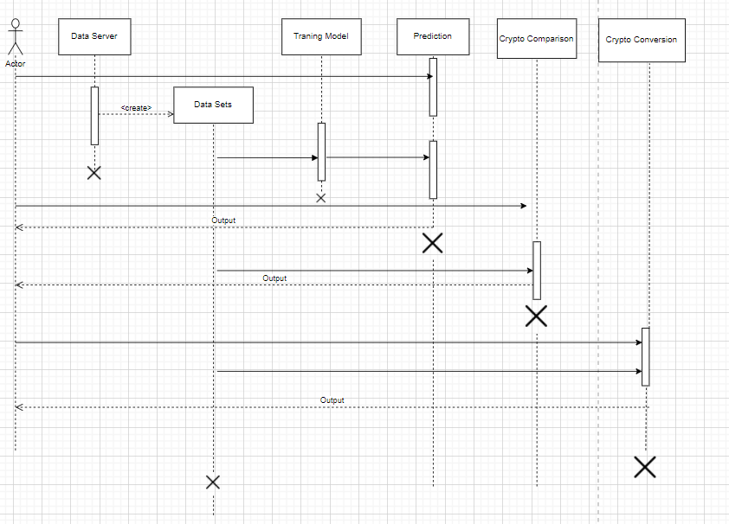
Sequence diagram
28/05/2022

Slide 12
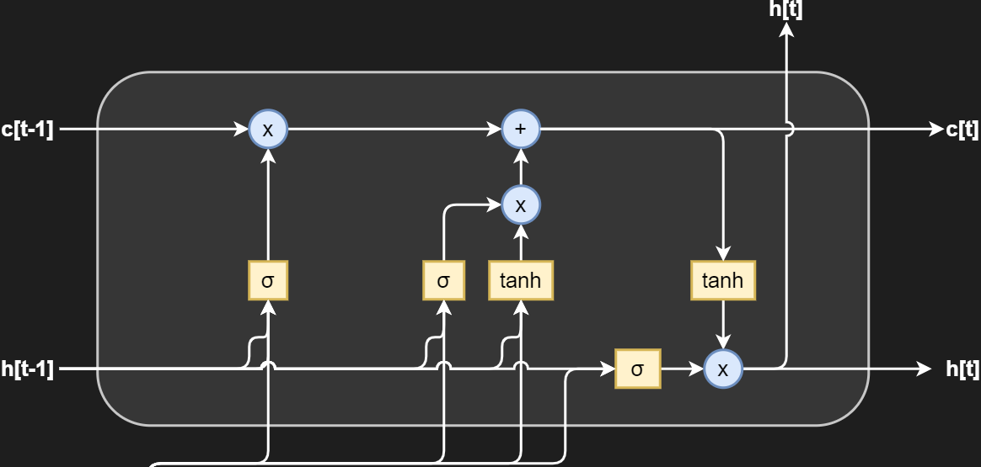
CONCEPT OF LSTM

Slide 13
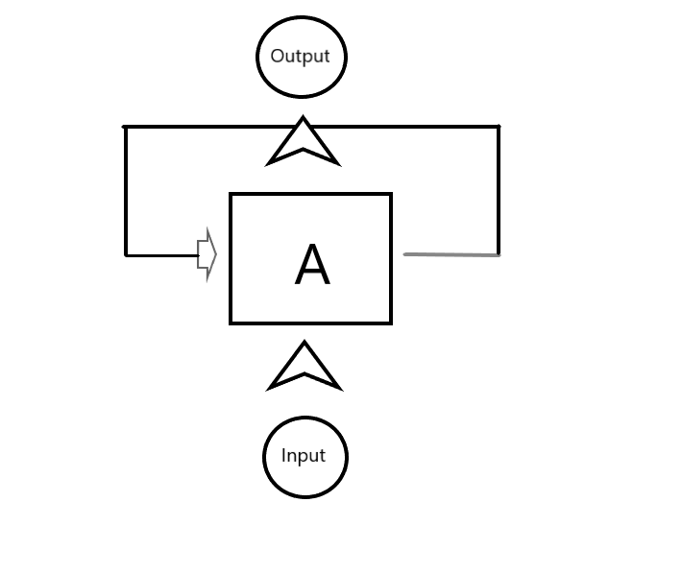
RECURRENT NEURAL NETWORK
One of the type of neural network.
Uses feed backward method.
Input-Output depends on each other.
Solves the issue of prediction.
Advantage of hidden layer.
Remember the sequence.
Contain a memory for calculation.
Same the of input for all the neurons .
28/05/2022

Slide 14
LSTM (Long short term memory)
An LSTM is a type of recurrent neural network
Solves the vanishing gradient problem in backpropagation.
Uses a gating mechanism for memoring.
LSTM can stored and read via gates.
Gates do operations in analog format.
Sigmoid and Tanh activation functions are used .
Best for Prediction problems.
28/05/2022

Slide 15
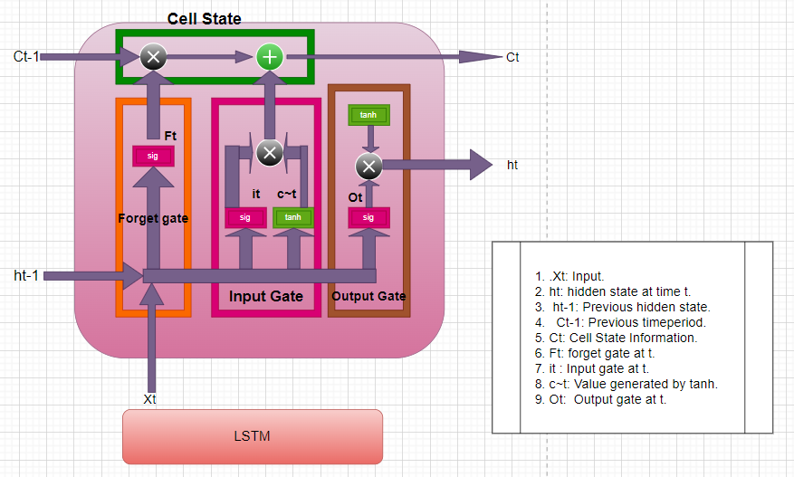
The Architecture of LSTM
Use for both:
LTM (Long term memory)
STM (Short term memory)
Made up three gates:
Forget gate
Input gate
Output gate
3. Cell State: decides which information
to store.Inputs from forget
gate and Input gate added
in it.
28/05/2022

Slide 16
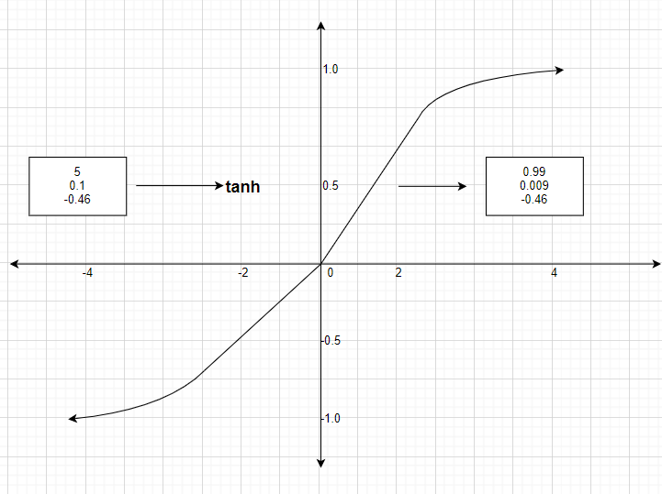
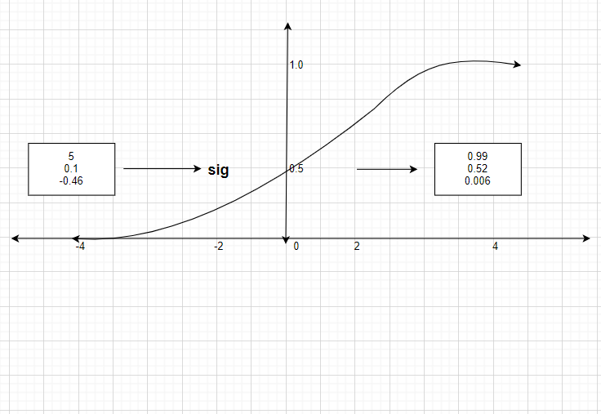
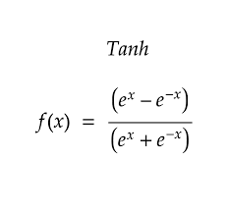
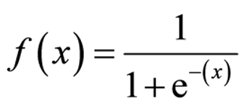
Activation Function
Tanh function
Sigmoid function
28/05/2022

Slide 17
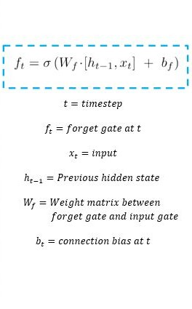
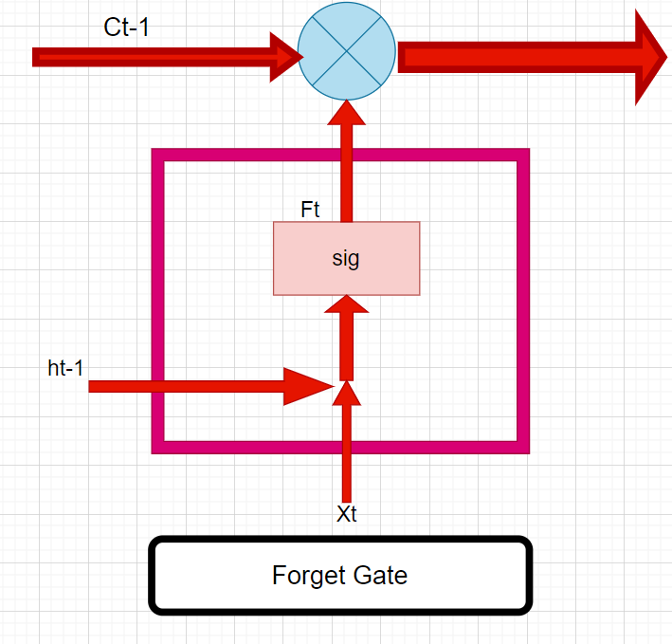
Forget Gate
28/05/2022

Slide 18
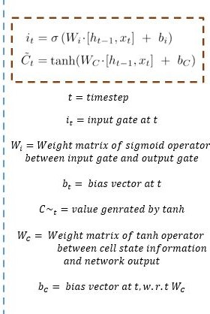
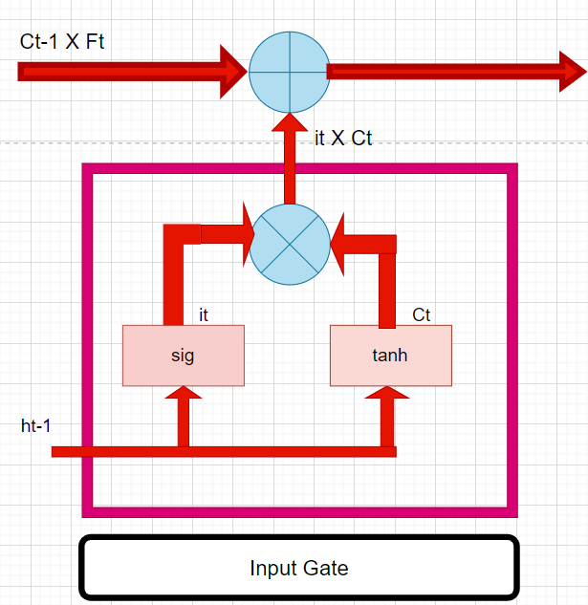
Input Gate
28/05/2022

Slide 19
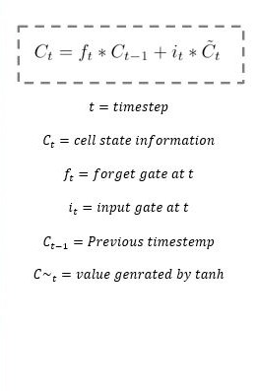
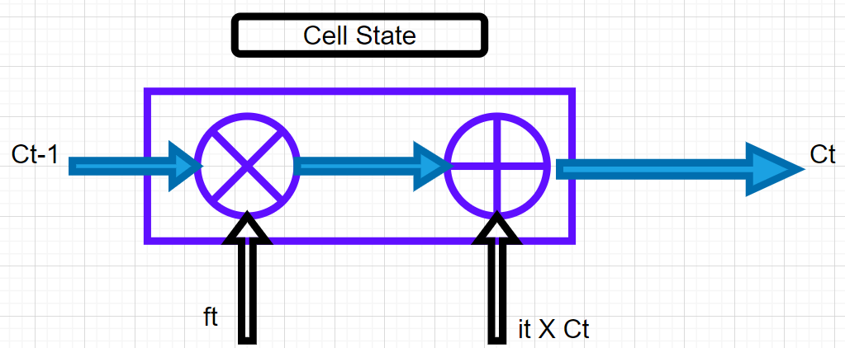
Cell State
28/05/2022

Slide 20
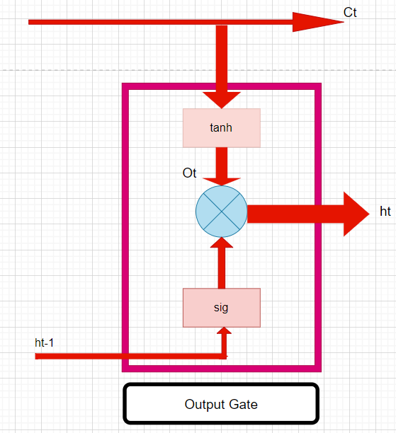
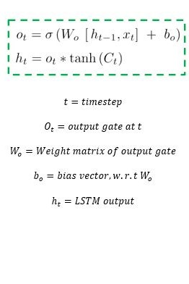
Output Gate
28/05/2022

Slide 21

Implementation
28/05/2022

Slide 22
Software and Hardware requirements
Softwares required:
Jupyter notebook
Any operating system (Windows/mac/linux)
Hardwares required
Minimum 2 Gb RAM
Minimum intel i3 Processor
Active Internet.
28/05/2022

Slide 23
Proposed System Model
Installation of Important machine learning libraries
Data set collection
Data Analysis over collected data.
Data Normalization
Preparing for training model
Use of LSTM bidirectional concept for data training.
Optimization and training of the data.
Using 80% dataset for training and 20% for testing purpose.
Analysis of training model using graphical representation.
Prediction of values for 160 days using training data.
Analysis of Prediction model using graphical representation.
28/05/2022

Slide 24
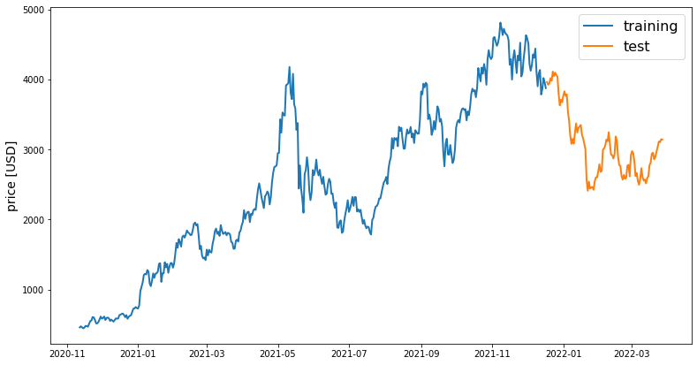
Training and Testing Graph
Training And Testing Graph.
28/05/2022

Slide 25
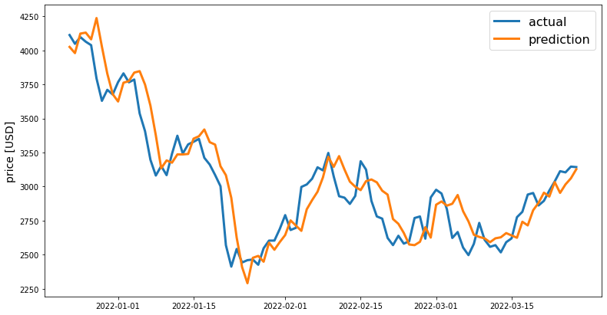
Prediction of price wrt time.
28/05/2022

Slide 26
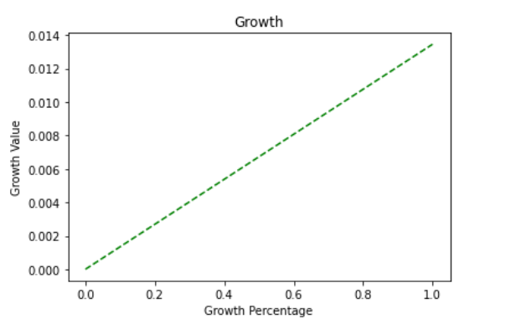
Crypto-Growth Comparison
ETH growth in future Bianance growth in future
28/05/2022

Slide 27
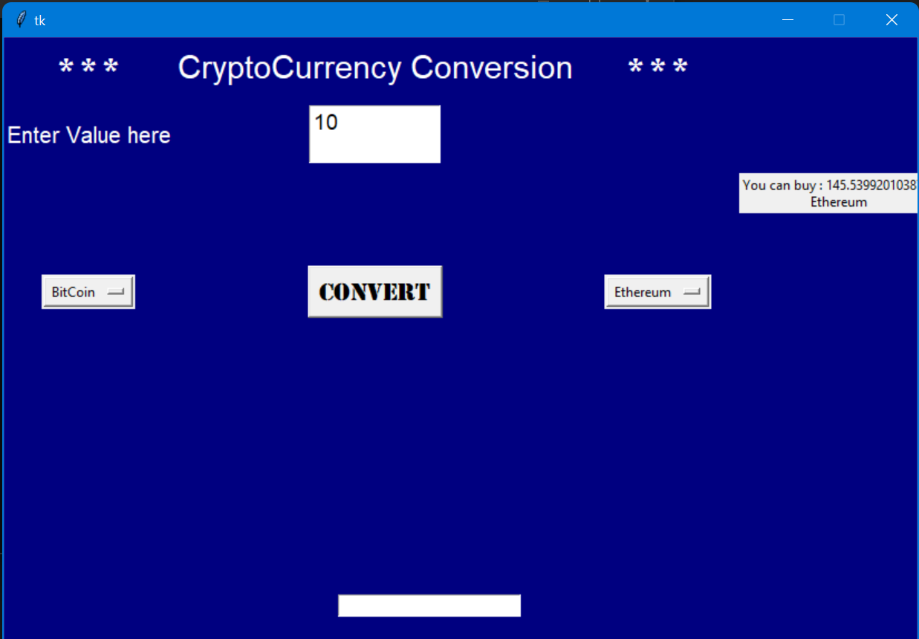
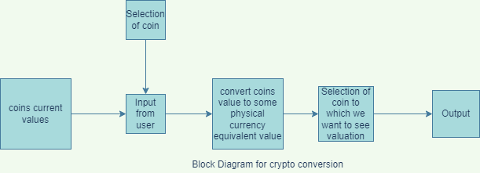
Crypto-Value Convertor
28/05/2022

Slide 28
Testing
In this project we have performed debugging oriented testing.
This is a type of testing in which developer were expected to debug the product while building it.
Tests were not documented and heuristically conducted.
Testing was considered to check correct working of implementation (positives testing)
With this we also did White box testing
28/05/2022

Slide 29
Conclusion:
By implementing this tool, anyone can do research on Cryptocurrencies prices on different dates this tool is capable of predicting the future values of given Cryptocurrencies and comparing different Cryptocurrency.And it also convert one currency value with other to give investors a clear view of prices.
28/05/2022

Slide 30
References:
We take many references from different research paper and various reports.
Karasu, Seçkin, et al. "Prediction of Bitcoin prices with machine learning methods using time series data." 2018 26th signal processing and communications applications conference (SIU). IEEE, 2018.
Phaladisailoed, Thearasak, and Thanisa Numnonda. "Machine learning models comparison for bitcoin price prediction." 2018 10th International Conference on Information Technology and Electrical Engineering (ICITEE). IEEE, 2018.
McNally, Sean, Jason Roche, and Simon Caton. "Predicting the price of bitcoin using machine learning." 2018 26th euromicro international conference on parallel, distributed and network-based processing (PDP). IEEE, 2018.
Velankar, Siddhi, Sakshi Valecha, and Shreya Maji. "Bitcoin price prediction using machine learning." 2018 20th International Conference on Advanced Communication Technology (ICACT). IEEE, 2018.
Rathan, Karunya, Somarouthu Venkat Sai, and Tubati Sai Manikanta. "Crypto-currency price prediction using decision tree and regression techniques." 2019 3rd International Conference on Trends in Electronics and Informatics (ICOEI). IEEE, 2019.
28/05/2022

Slide 31
Thank You
28/05/2022

